Slide 1

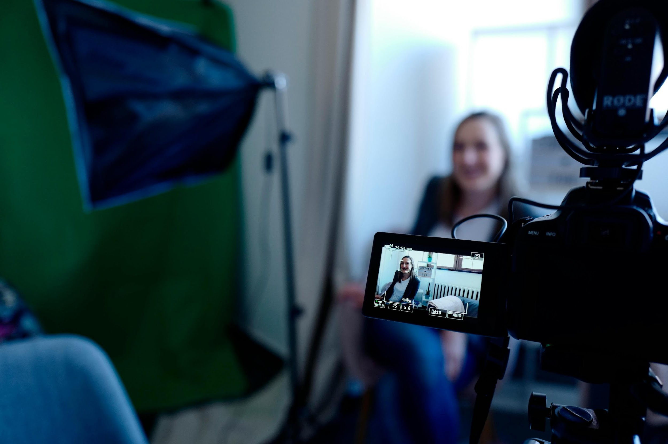


Considerations for
FAIR video material
Chapter 6 – FAIR Training Material by Design
October 21-22, 2025
Ineke Luijten, PhD
Cite presentation as: Ineke Luijten (2025) Considerations for FAIR video material (Session 6 presentation). In course: Training material made FAIR by design, organized by: VIB, SciLifeLab, NBIS. Available under a CC BY 4.0 license. https://doi.org/10.5281/zenodo.14987327
Notes:
Title: "Considerations for FAIR video material"
Slides author:
name: "Ineke Luijten"
ORCID: 0000-0001-5768-275X
email: ineke.luijten@scilifelab.se
Part of: FAIR Training Material by Design
Url: https://elixir-europe-training.github.io/ELIXIR-TrP-FAIR-Material-By-Design/latest/
duration: 60 min

Slide 2
Learning outcomes
Explain why video materials should follow FAIR principles and identify key challenges in doing so
Evaluate how FAIR a given video is, using real examples
Apply minimum FAIR-by-design practices when creating or sharing training videos
Generate and use transcripts or captions to enhance accessibility and interoperability (via Whisper AI or similar tools)

Slide 3

Why FAIR video materials matter
Have you used / are you planning to use video material in your training?
What kind of video material?
Why / why not?
Notes:
Reflection questions, discuss with students to determine their familiarity and needs with regards to video material in training

Slide 4
Why FAIR video materials matter
Video media is a great tool for enhancing & contextualizing learning!
Improved retention and understanding: combining visual and auditory information engages multiple senses → dual coding theory ^{1, 2}
Supports flexible, self-paced learning: learners can pause, rewind, or rewatch segments at their own pace ^{3, 4}
Enables asynchronous learning: learners access materials anytime, anywhere
Provides authentic demonstrations: e.g. when teaching lab techniques, workflows, or software use
Increases accessibility and inclusion: captions, transcripts, and translations make content more widely usable
¹Paivio A (2009) Mental Representations: A dual coding approach, Oxford Psychology Series. https://doi.org/10.1093/acprof:oso/9780195066661.001.0001
² Mayer RE (2009) Multimedia Learning. 2nd ed. Cambridge University Press. https://doi.org/10.1017/CBO9780511811678
³Guo P, Kim J, Rubin R. (2014) How video production affects student engagement: An empirical study of MOOC videos. L@S '14: Proceedings of the first ACM conference on Learning @ scale conference 41-50. https://doi.org/10.1145/2556325.2566239
⁴Zhang D, Zhou L, Briggs RO, Nunamaker JF (2006) Instructional video in e-learning: Assessing the impact of interactive video on learning effectiveness. Information & Management 43(1): 15-27, https://doi.org/10.1016/j.im.2005.01.004
Notes:
Video materials are very valuable for learning and it is encouraged to add them to your course material.
First, video is a powerful medium because it engages multiple senses — both visual and auditory — which improves retention and understanding. This is supported by dual coding theory, which shows that combining different channels of information makes learning more effective.
Second, videos support flexible, self-paced learning. Learners can pause, rewind, or rewatch sections whenever they need, which is particularly helpful for complex topics.
Third, video allows asynchronous learning, meaning learners can access content anytime and anywhere, without being tied to a classroom or schedule.
Fourth, videos provide authentic demonstrations. For example, they’re perfect for showing lab techniques, workflows, or software use in a way that’s hard to convey through text alone.
Finally, videos increase accessibility and inclusion. By including captions, transcripts, and translations, we make content available to a wider audience, including those with hearing impairments or learners who speak different languages.”
Background on references
Dual Coding Theory (Paivio, 1971; 1986)
Core idea: We process information through two distinct but connected channels — one for verbal information (text, speech) and one for visual information (images, diagrams, video).
Learning implication: When both channels are used together (e.g., narration + visuals), learners build stronger mental connections and remember material better.
Focus: Cognitive processes (how information is represented and stored in the brain).
Common application: The theoretical foundation for Mayer’s Cognitive Theory of Multimedia Learning (CTML).

Slide 5
Why FAIR video materials matter
Screen recordings
Stock footage with reuse licenses
Open lectures
Webcam or smartphone footage
Podcasts
Zoom recordings
Powerpoint slideshows
Recorded interviews
Professional studio recordings
Voiceovers
Livestreams
Notes:
There are many ways to use video as a training resource, for example: voiceovers added to slides or presentations, screen recordings showing workflows/coding/software demonstrations, interviews with experts or practitioners, lecture recordings or seminars, animations and explainer videos, hands-on demonstrations in labs or fieldwork settings. All of these can be made FAIR!
Let’s now have a look at what it takes to FAIRify video material:

Slide 6

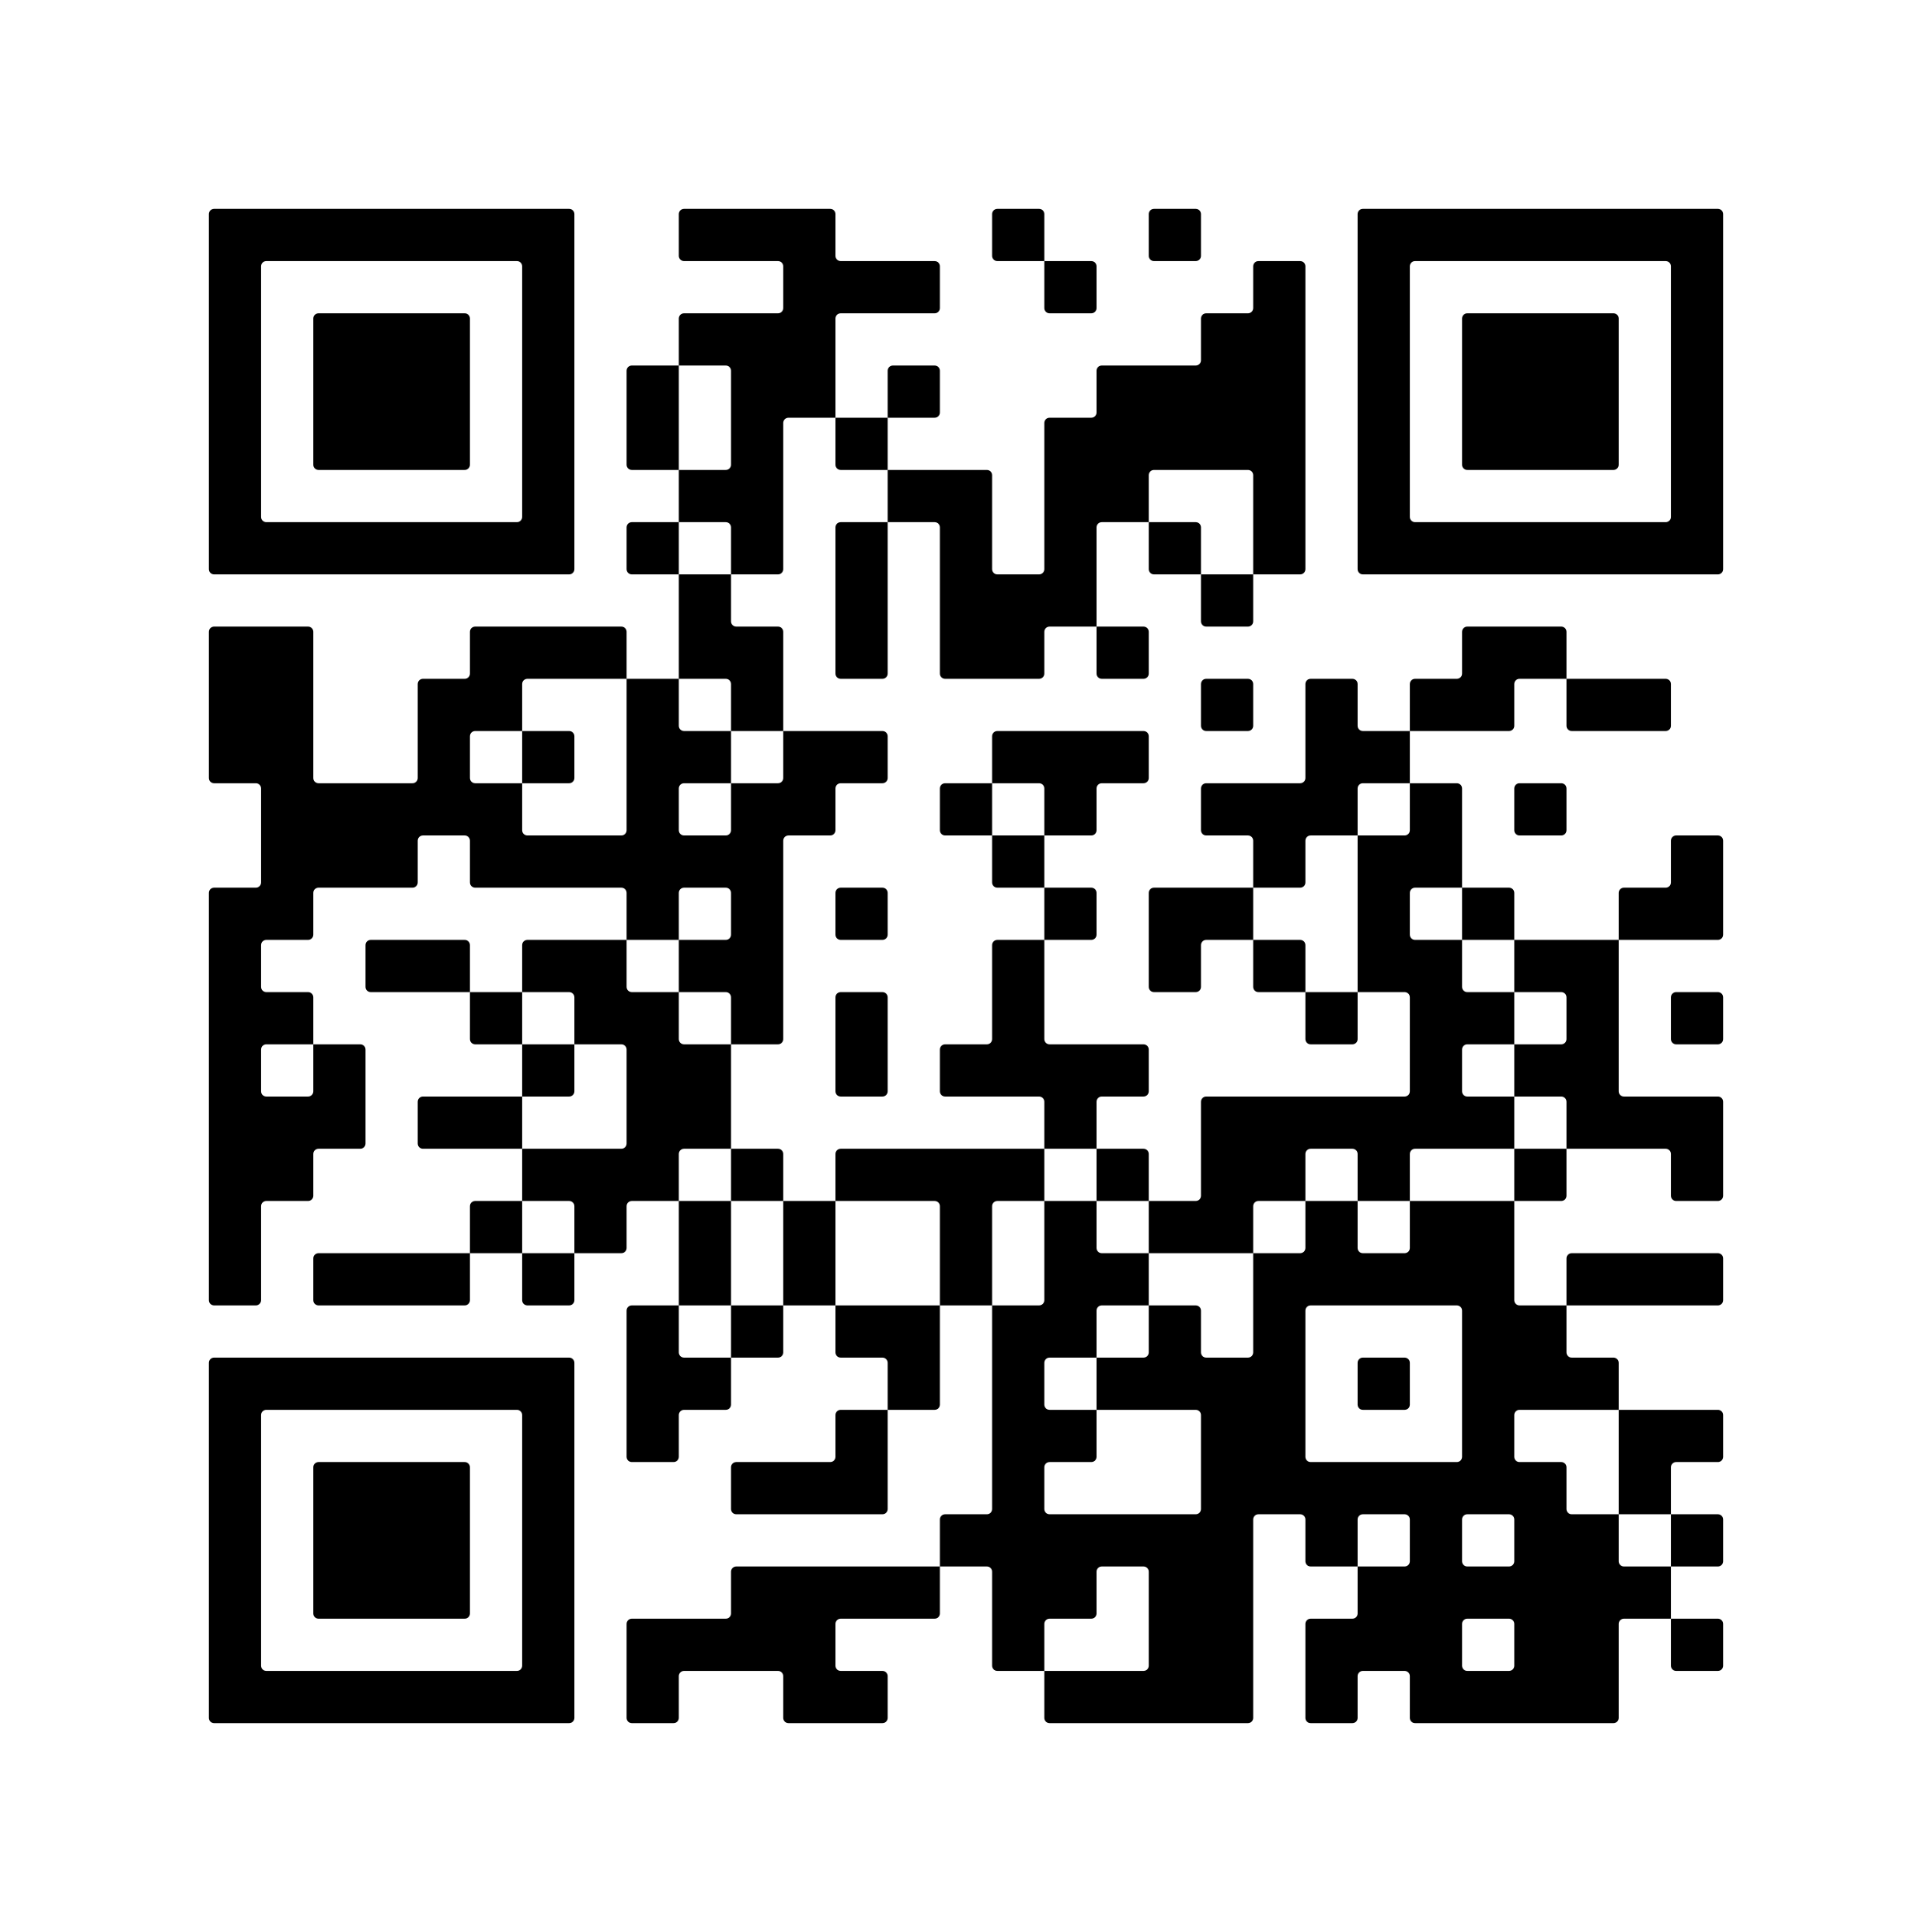
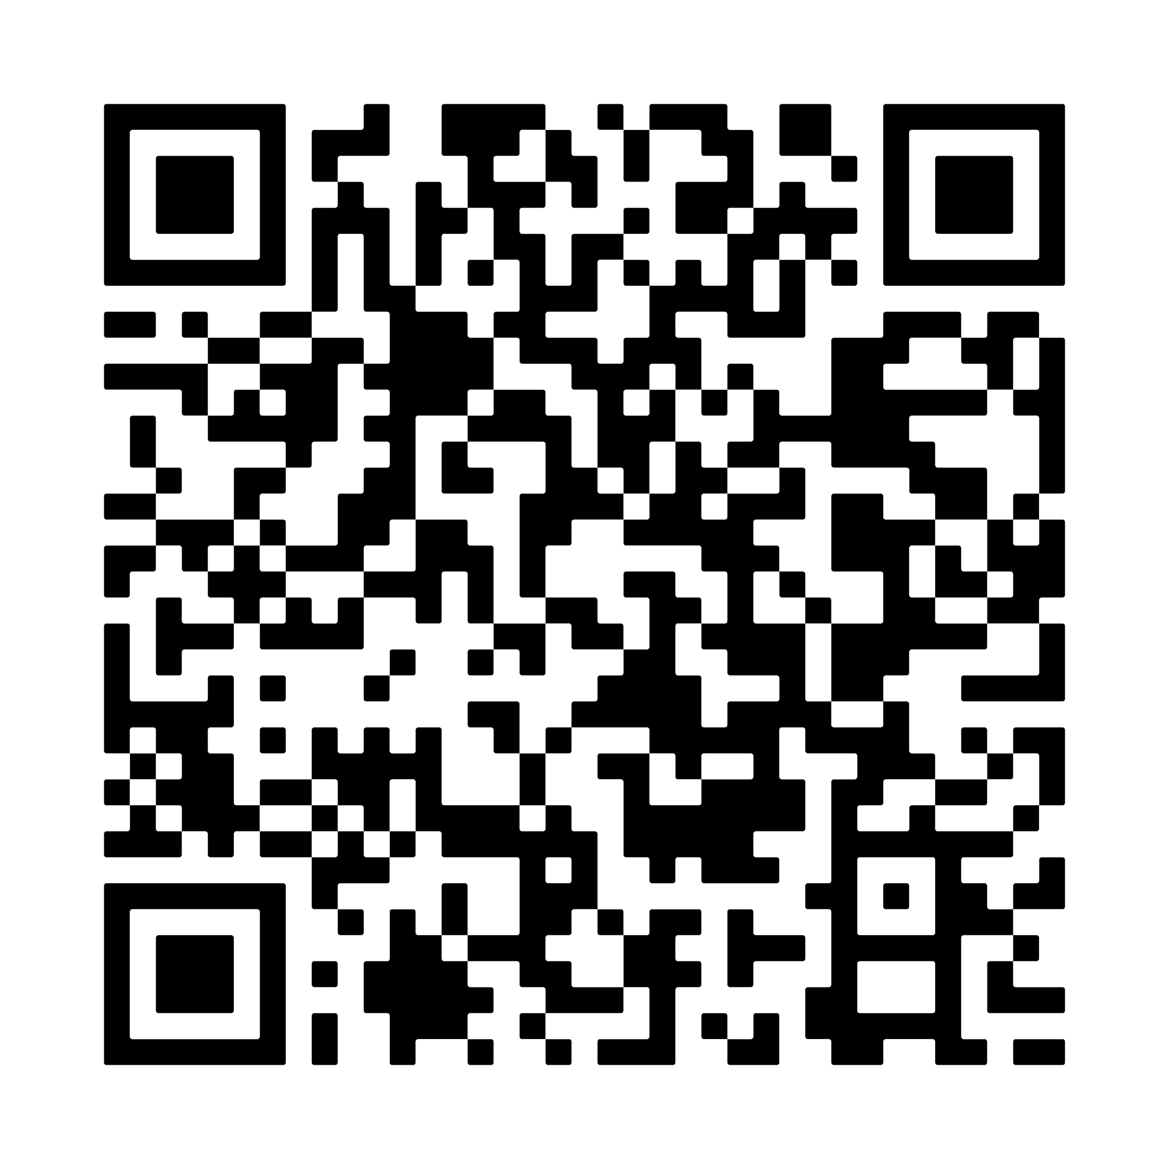
Why FAIR video materials matter
Action!
Find a short video (e.g., on YouTube, Protocols.io, Zenodo, or another platform) that you might want to include in your course. Once you’ve found one, take 5–10 minutes to assess:
Is it Findable? → located at a trusted hust? Does it have a DOI?
Is it Accessible? → Is access level/language defined? Is it possible to download a copy?
Is it Interoperable? → Are there captions? Is the format standard?
Is it Reusable? → Is there a clear license? Is proper attribution given to (non)human creators? Is there versioning info?
Links to sample videos
Notes:
Exercise 5 min: individually, students find a short video that they might want to include in their course. They can also include 1 of the sample videos that are linked with the QR codes.
For the chosen short video, they need to assess if it is:
Findable
Include the video link in the DOI record (and vice versa) so both are cross-referenced.
Choose a reliable video host that aligns with your target audience and long-term availability (e.g., institutional repository, Zenodo, YouTube, etc.).
Add descriptive titles, keywords, and metadata to improve discoverability.
Accessible
Clearly define access type and language in the video’s metadata (e.g., open, restricted, embargoed).
Offer a downloadable version where possible to avoid access loss if the host changes.
Interoperable
Attach transcripts or captions (.srt or .txt) to the DOI record or repository entry.
Use standard, widely supported video formats (.mp4, .mov, .webm) for compatibility.
Ensure metadata follows community or repository standards (e.g., Dublin Core, schema.org).
Reusable
Apply a clear, open license (e.g., CC-BY, CC-BY-SA) to indicate reuse permissions.
Provide proper attribution information for all contributors.
Clearly label any AI-generated or AI-assisted content, following institutional or platform guidelines.
Include creation and version information to support reuse and citation.
They can asses with help of the Checklist for minimally FAIR video material where they can documents their findings

Slide 7

Why FAIR video materials matter
Evaluate
Was the video material you chose FAIR?
How easy would it be for you to reuse this material?
If not easy: what information would you need to make reuse easier?
Notes:
Evaluation after exercise 5min, discuss plenary with the students:
was the video material you chose FAIR?
How easy would it be for you to reuse this material?
Conclusions:
We see that video content ≠ automatically learning material, and doesn’t mean it’s automatically fit for reuse.

Slide 8
Why FAIR video materials matter
It makes it easy to locate videos
It supports asynchronous learning when videos can be viewed or downloaded anytime, anywhere
It enables using videos across platforms and tools
It allow others to legally adapt or remix content
It ensures videos remain available and understandable over time
FAIR video = more impact from the effort you put into creating it
Notes:
To enable reuse and long-term value videos need to be FAIRified! There are numerous benefits to having FAIRified video material:
First, FAIRifying videos makes them easy to locate. Proper metadata and standardized descriptions mean anyone can find the content they need quickly.
Second, it supports asynchronous learning. When videos are easily accessible online, learners can watch or download them anytime and anywhere.
Third, FAIR videos can be used across different platforms and tools. This interoperability ensures that content can be integrated into various learning environments without technical barriers.
Fourth, FAIR videos allow others to legally adapt or remix content. This encourages collaboration, reuse, and the creation of derivative works in teaching or research.
Finally, FAIR practices ensure that videos remain available and understandable over time. With proper documentation, metadata, and file formats, the content won’t get lost or become obsolete.
In short, making videos FAIR increases the impact of the time and effort you put into creating them — your content reaches more people and stays useful for longer.
Advantages to FAIR video material
1. Discoverable & Accessible
Others can easily find and view your materials.
Supports asynchronous and flexible learning.
2. Reusable & Citable
Clear licensing and attribution allows others to reuse legally.
DOI and versioning make materials trackable and referable.
3. Interoperable & Inclusive
Captions, transcripts, and standard formats make content usable across platforms and by diverse learners.
Enhances accessibility for non-native speakers or learners with disabilities.
4. Preserves Knowledge
Proper metadata and hosting choices ensure materials are maintained for the long term.

Slide 9
Barriers to creating FAIR video materials
What’s the biggest barrier for you in using and FAIRifying video material?
Notes:
Making video materials FAIR can be highly rewarding — but it’s not always straightforward. There are practical, technical, and even ethical challenges that educators and trainers often face.
Reflection questions, discuss with students to determine their barriers with regards to FAIRifying video material in training

Slide 10
Barriers to creating FAIR video materials
Infra-
structure
Technical skills
Time consuming
File size / storage limits
Knowledge gaps
Metadata complexity
AI & Ethics
Licensing & permissions
Notes:
Here are some of the most common obstacles encountered when creating or sharing FAIR video materials:
Technical Skills: Recording, editing, adding metadata, and creating captions require some know-how.
Licensing & Permissions: Confusion about copyright, reuse rights, and privacy when sharing video content.
File Size & Storage Limits: High-quality video files are large, making them harder to host on institutional repositories or platforms like Zenodo (often limited to 50 GB per upload).
Metadata Complexity: Video materials often need multiple layers of metadata (e.g., author, content, format, transcript, licensing), and it’s not always clear where or how to include these.
Time consuming: Creating, editing, and annotating videos takes planning and effort.
AI & Ethics: Emerging tools (e.g., for transcription or editing) raise questions about bias, transparency, and attribution.
Infrastructure: Not all organizations have repositories or tools for storing videos with FAIR metadata.
Knowledge Gaps: Limited awareness of FAIR video practices or suitable hosting platforms.

Slide 11
AI and FAIR video material
Create
Record
Edit
Transcribe
Host / Publish
Evaluate
Generate ideas, scripts, storyboards:
ChatGPT, Claude, Gemini
Capture lectures, demos etc:
Microsoft Text-to-Speech
Refine video, combine visuals:
CapCut, Canva Video
Generate captions and transcripts:
Whisper AI
Share with metadata & licensing:
Zenodo, YouTube, Vimeo
Review viewer engagement:
YouTube Analytics, EdX insights
Notes:
A potential way to mitigate some of the barriers to FAIR video materials is to use AI tools at different stages of video creation. The workflow in the slide illustrates which tools, some of which use AI, can support each stage:
For example, ChatGPT can help outline your message or even write a script, while text-to-speech tools can give you a professional-sounding voiceover without recording yourself. Editing tools like CapCut or Canva simplify trimming, adding text overlays, and improving visuals — no advanced skills needed. Whisper, which we’ll look at later, can automatically generate captions and transcripts, improving Accessibility and Interoperability.

Slide 12
AI and FAIR video material
Create
Record
Edit
Transcribe
Host / Publish
Evaluate
Generate ideas, scripts, storyboards:
ChatGPT, Claude, Gemini
Capture lectures, demos etc:
Microsoft Text-to-Speech
Refine video, combine visuals:
CapCut, Canva Video
Generate captions and transcripts:
Whisper AI
Share with metadata & licensing:
Zenodo, YouTube, Vimeo
Review viewer engagement:
YouTube Analytics, EdX insights
BUT: Use with caution! Is AI generated content FAIR? How to ensure quality and accuracy? How does AI affect creativity and learner engagement? Who is the author, how should we credit them?
Notes:
However, while AI can speed up production and reduce workload, it’s important to remember that using AI does not automatically make content FAIR!
For example, an AI-generated transcript may improve accessibility, but if it is not properly formatted, licensed, or shared with metadata, it will not be findable or reusable.
Likewise, AI platforms may store outputs in proprietary formats or behind authentication walls, limiting accessibility and interoperability. Ensuring FAIRness thus requires deliberate steps by the creator, such as applying open licenses, adding persistent identifiers, using open formats, and providing rich, structured metadata.
In addition, it is important to reflect on how AIT tools might affect learning? What biases might specific AI output be subject to? Where would you not want to use AI tools? Can discuss among students

Slide 13
AI and FAIR video material
Crediting and Citing AI-Enhanced Video Materials
Crediting AI:
For AI tools that had a creative or technical role: “Script generated with ChatGPT (OpenAI, 2025)”
Describing the role of AI:
Explain how an AI tool was used, e.g. “Voiceover synthesized using Microsoft Azure TTS”
Crediting AI in metadata or end credits:
“Video created by [Name], 2025. Script drafted with ChatGPT (OpenAI, version x.x). Captions generated using Whisper (OpenAI). Edited in CapCut.”
Citing AI in reference lists or FAIR records: Luijten, I. (2025). Creating FAIR video materials [Video]. Script generated with ChatGPT (OpenAI). Captions via Whisper (OpenAI). Zenodo. https://doi.org/10.xxxx/zenodo.xxxxx
Licensing AI generated content:
License with CC BY or CC BY-SA to allow reuse with attribution, state if remixing or AI reuse is permitted.
Notes:
If you do decide to use AI tools in your video creation process, it is important to indicate its contribution properly to ensure transparency, maintain trust, and support FAIR principles. Properly stating AIs contribution makes the provenance of your materials understandable for both humans and machines, and helps others to responsibly reuse or adapt your video content.
On this slide you can see an overview of how to credit and cite AI-enhanced video materials.

Slide 14
AI and FAIR video material
WhisperAI: adding transcripts to videos
Findable: search engines and repositories can index the text and help
others discover your content.
Accessible: people with hearing impairments or those who prefer reading
can still engage with the material.
Interoperable: the content can be reused across different platforms,
formats, or languages.
Reusable: the text can be cited, translated, remixed, or integrated into
other learning materials, all while preserving the original meaning and context.
Notes:
One essential step in FAIRifying video training materials that we will practice today is adding captions or a transcript, because it transforms the spoken content into machine-readable and searchable text.
Adding captions improves FAIR in the ways you can read on the slide.

Slide 15
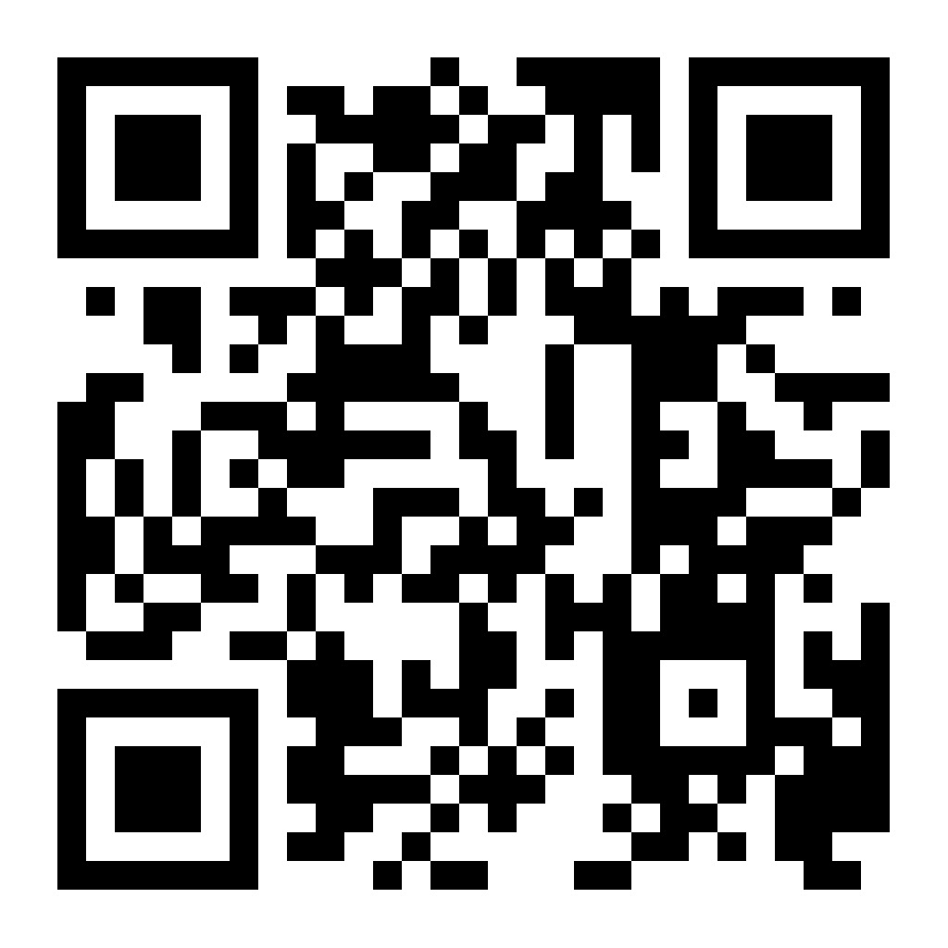
AI and FAIR video material
Action!
Generate a caption or transcript to a sample video
Recommended: Using the SciLifeLab serve instance of Whisper (recommended, easy)
Independent: Using an on-device GUI such as Whisper Transcription
Challenge mode: Installing your own local instance of Whisper
Link to sample video
Notes:
Exercise 10-15 min:
Designed to give students hands-on practice with generating transcripts and captions. There are three levels of difficulty available, but for this course, we recommend completion of Level 1, which is suitable for beginners and covers the core skills needed to make videos FAIR by adding a transcript or caption.
During the course:
Navigate to the whisper container
https://whisper-ai.serve.scilifelab.se/
Upload your video file
Select the output format(s) - .txt for transcript and .srt for captions
Submit the file
When the file has completed transcription, the output will download to the student’s computer.

Slide 16

AI and FAIR video material
Evaluate
Is the transcript accurate?
Is it usable?
How does it help me achieve FAIR learning aims?
The word error rate (WER) for the large Whisper model is 4.1% for English and 7.6% for Swedish.
Notes:
Evaluation after exercise 5min, discuss plenary with the students:
Is the transcript accurate?
Is it usable?
How does it help me achieve FAIR learning aims?
Make captions FAIR!
Include language codes (e.g., en, sv).
Add metadata about who created the transcript and when.
Store the caption file in your repository along with the video.
Assign a persistent identifier (PID) if possible.

Slide 17
Adding FAIR video & transcript to your sample course
Action!
Publish your own FAIR-by-design training video
Use the sample video to embed or feel free to upload your own video to your host of choice
Attribute the video and choose a license
Add your caption file
Links to sample video
Notes:
In this final exercise (30min), you will practice publishing your own FAIR-by-design training video. Following the basic guidelines below, add your video and its transcript or captions to your sample course page. This step helps make your learning material more FAIR by ensuring that your video content is well-described, openly shared, and accessible to all learners.
Follow the instructions here https://elixir-europe-training.github.io/ELIXIR-TrP-FAIR-Material-By-Design/latest/chapters/chapter_06/

Slide 18

You now have FAIR video material in your course!
Cite presentation as: Ineke Luijten (2025) Considerations for FAIR video material (Session 6 presentation). In course: Training material made FAIR by design, organized by: VIB, SciLifeLab, NBIS. Available under a CC BY 4.0 license. https://doi.org/10.5281/zenodo.14987327

Slide 19
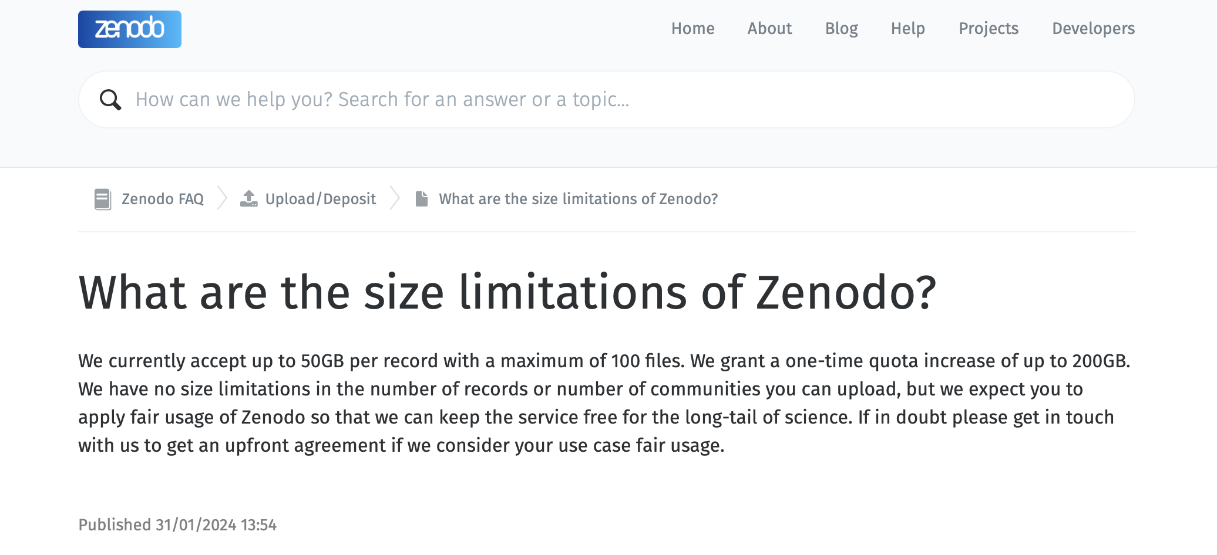
More tools for FAIR video material
🪄
✂️
Create
Edit
Release
🍿
Capture:
Zoom
Powerpoint
Your smartphone
OBS Studio
Open material:
Pexels
Pixabay
Open source:
Blender
Kdenlive
OBS Studio
Proprietary:
iMovie
Adobe Premiere
Many others
Hosting options:
YouTube
Vimeo
Nextcloud
Google Drive
Zenodo*

